Slide 1
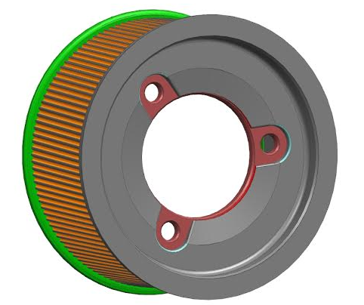
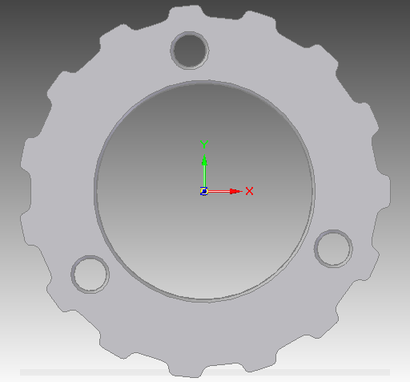
CCM 84: Over-molded Plastic Pulley Development
Last updated: 28OC15
Replace bolt-on metal pulley with plastic over-molded design
Led by Ford P552/S550
Motivation: 6
Deliverables
Baseline against current design
Design strategy for use in applications
Timing
System level validation expected Q4 2015
Design strategy expected Q1 2016
Team Members/Customers
Team: Emily Stilwell / Kevin McClendon
Customers: REPS application teams

Slide 2
CCM 84: Over-molded Plastic Pulley Development
Last updated: 28OC15
Status Update:
$2.30 piece price savings from powder metal design
Production tooling kicked off in September
Component durability testing in-process
P552/S550 LOAA Phase 2 DV in-process
Concentrated steer
Parking & Fatigue
Impact (complete)
Design recommended for programs with steel bolt-on pulleys as an MCIP item
Recommend future programs use press-fit pulley to ball nut
Challenges:
Supplier development of over-molding process
Assist mech availability
Durability stand availability
Next Actions:
Complete baseline testing
System level DV testing
Design strategy for retrofitting

